Slide 1
CS 646 Presentation: Software as a Service (SaaS)
Prithul Sarker

Slide 2
Learning outcome
Brief overview of Software as a Service
History of SaaS
Types of SaaS
SaaS model
Comparison with IaaS and PaaS
Advantages and drawbacks of SaaS

Slide 3
What is SaaS
Software as a Service (SaaS) is a software delivery model in which software and its associated data are hosted centrally and accessed using a thin-client, usually a web browser over the internet.
Simply put, SaaS is a form of cloud computing that delivers a cloud application and all its underlying IT infrastructure and platforms to users.
COVID-19 has acted as a catalyst and many companies are shifting to remote work for the longer term and need to pivot to SaaS-based offerings.

Slide 4
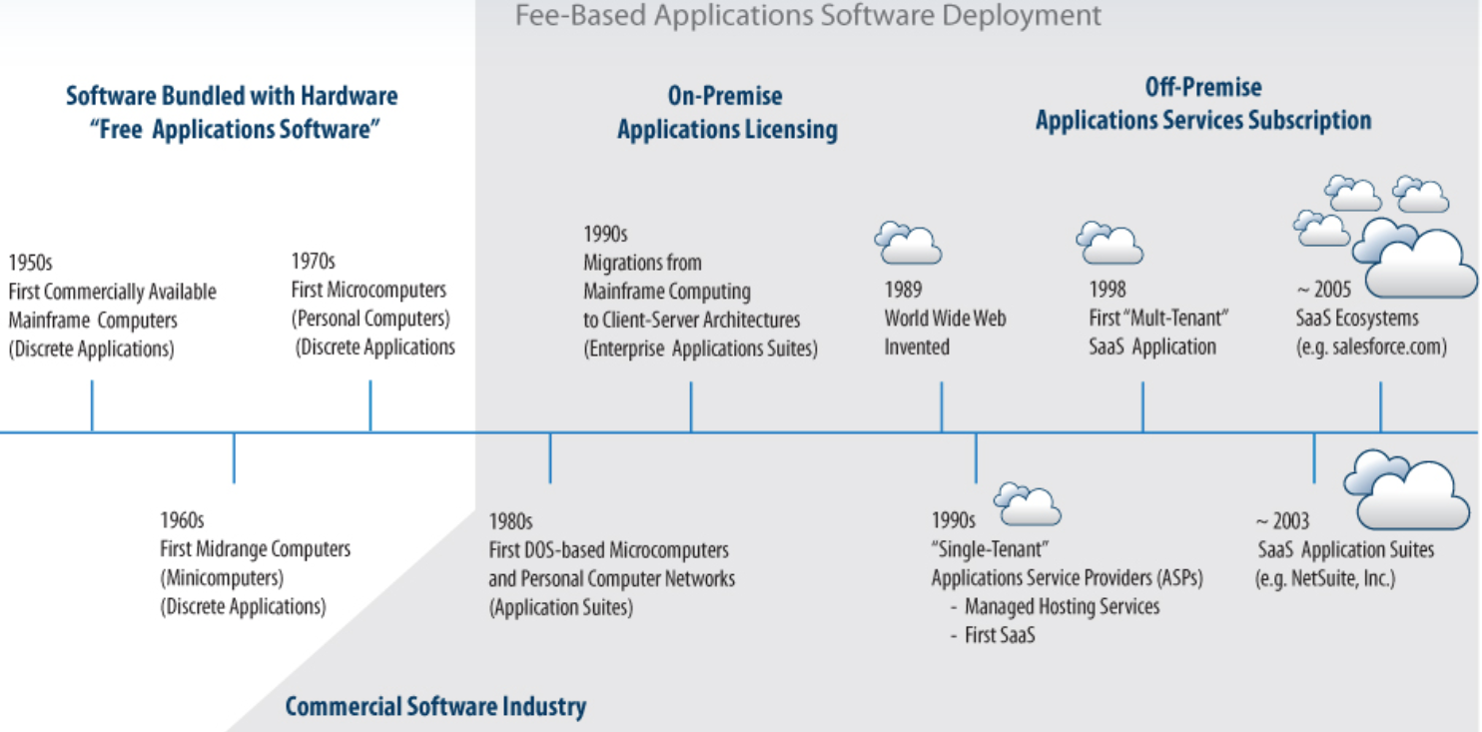
History of SaaS

Slide 5
Horizontal vs Vertical SaaS
Horizontal SaaS: Instead of focusing on solving the specific business problems of one particular industry, they offer a broader range of tools that serve companies across industries and borders.
Examples: Salesforce offers CRM and workflow automation tools suitable for virtually any industry.
Vertical SaaS: Vertical SaaS refers to software solutions specifically designed for a specific industry need.
Examples: Opentable is a table booking system tailored to restaurants.

Slide 6
SaaS Model
Subscription Model – Monthly or Annual
Initial setup cost for SaaS is typically lower than the equivalent enterprise software.
Opportunities also exist to charge per transaction, event, or other units of value, such as the number of processors required.

Slide 7
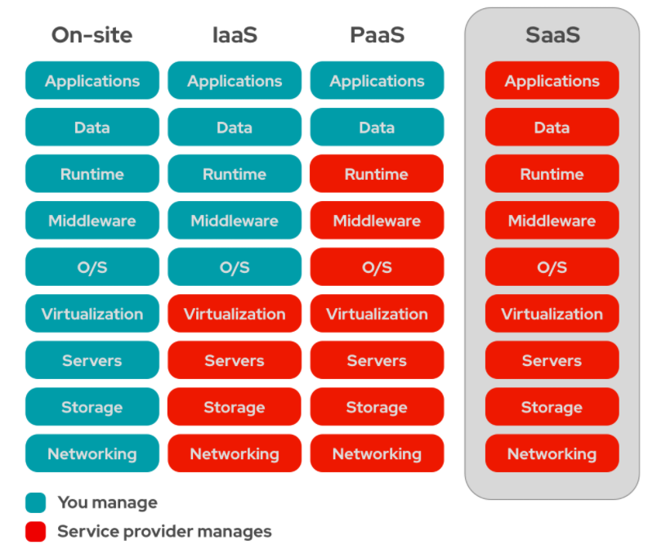
Comparison with other as a services

Slide 8
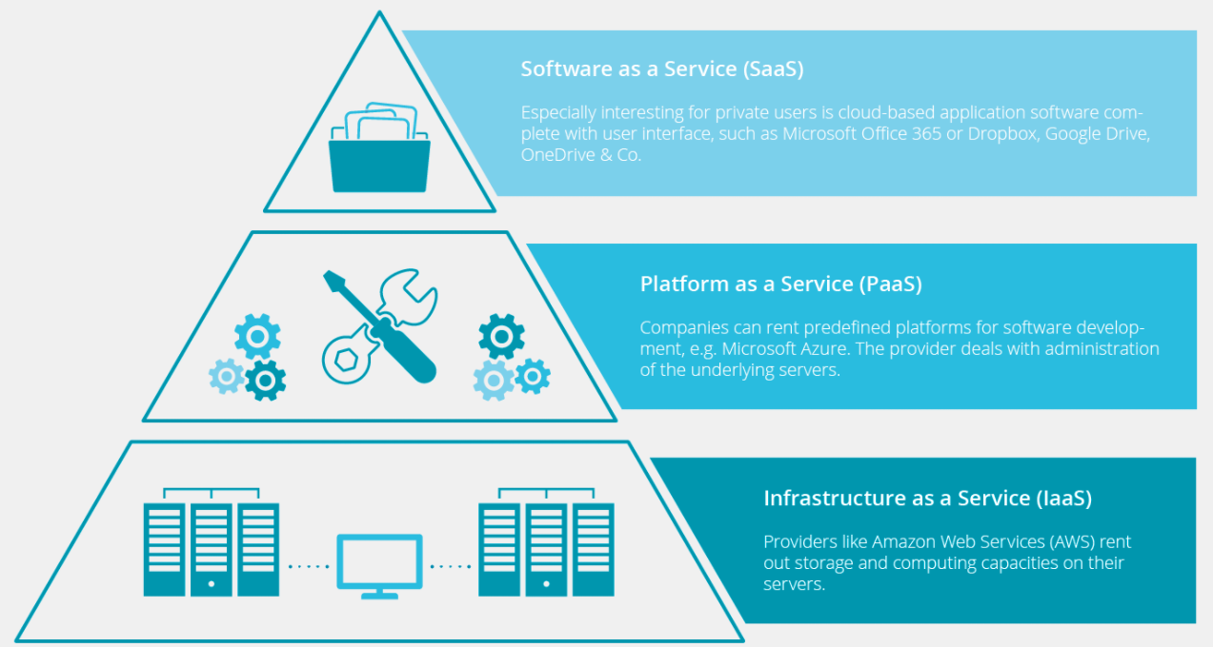
Comparison with other as a services

Slide 9
Advantages of SaaS
Easy to use
Cheap
Scalability
Less prone to data loss
Do not require users to install/uninstall binary code on their machines
Cross Device
Collaboration
Agile development life cycle

Slide 10
Drawbacks of SaaS
Robustness:
SaaS software may not be as robust (functionality wise) as traditional software applications due to browser limitations.
Privacy:
Having all of a user’s sensitive data sit in the cloud raises security & privacy concerns.
Security:
Prone to attack
Not sure what you agreed to
Reliability:
Difficult to recover from the server down time.

Slide 11
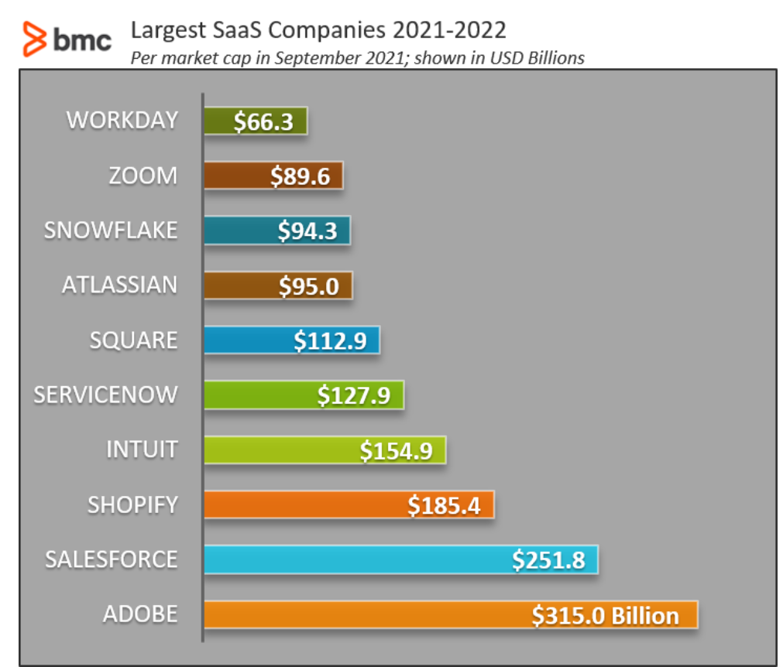

Slide 12
Reference
https://en.wikipedia.org/wiki/Software_as_a_service
https://financesonline.com/10-saas-security-risks-concerns-every-user/
https://kinsta.com/blog/saas-products/
https://www.bmc.com/blogs/saas-growth-trends/
https://www.forbes.com/sites/theyec/2021/01/19/what-to-expect-from-the-rapidly-growing-and-evolving-software-as-a-service-market-in-2021/?sh=7321c5f73007

Slide 13
Thank you

